Slide 1
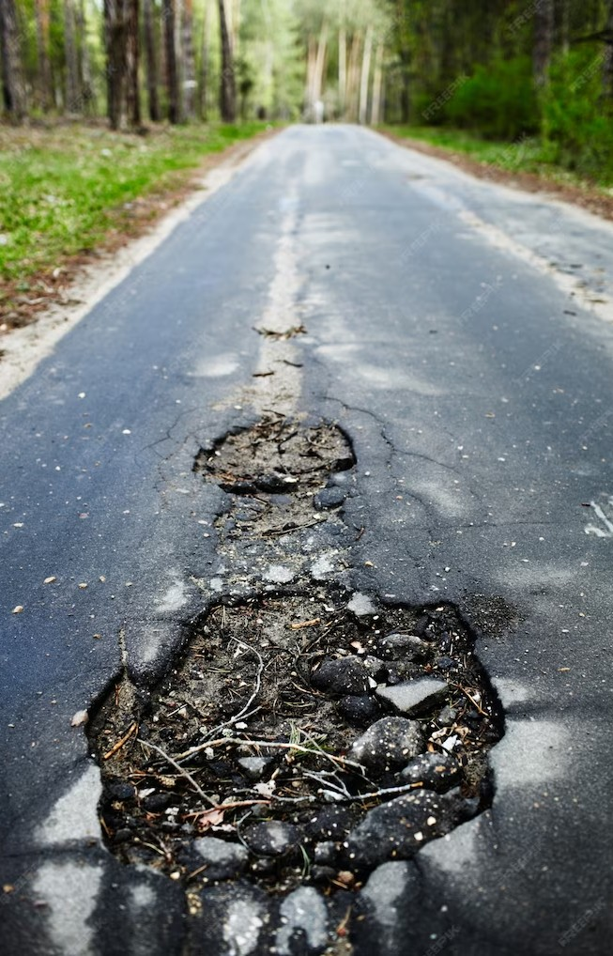

Unlocking the Value: E ploring Asset Tokenization for Enhanced Liquidity and Accessibility

Slide 2

Asset Tokenization
Asset tokenization is the process of converting the ownership of an asset into digital tokens that can be traded on a blockchain. This provides enhanced liquidity and accessibility to a wider range of investors. Tokenization can be used for various assets such as real estate, art, and even stocks.

Slide 3

Beneﬁts of Asset Tokenization
Asset tokenization provides several beneﬁts such as increased liquidity,
fractional ownership, and transparency.
It also reduces the need for intermediaries and provides access to a wider range of investors. Tokenization can also enable 24/7 trading and faster settlement times.

Slide 4

Real Estate Tokenization
Real estate tokenization enables fractional ownership of properties, which can be traded on a blockchain. This provides increased liquidity and accessibility to a wider range of investors. It also reduces the need for intermediaries and provides transparency in the ownership and
transfer of properties.

Slide 5

Art Tokenization
Art tokenization enables fractional ownership of artworks, which can be traded on a blockchain. This provides increased liquidity and accessibility to a wider range of investors. It also provides transparency in the ownership and transfer of artworks, which can help reduce fraud and forgery.

Slide 6
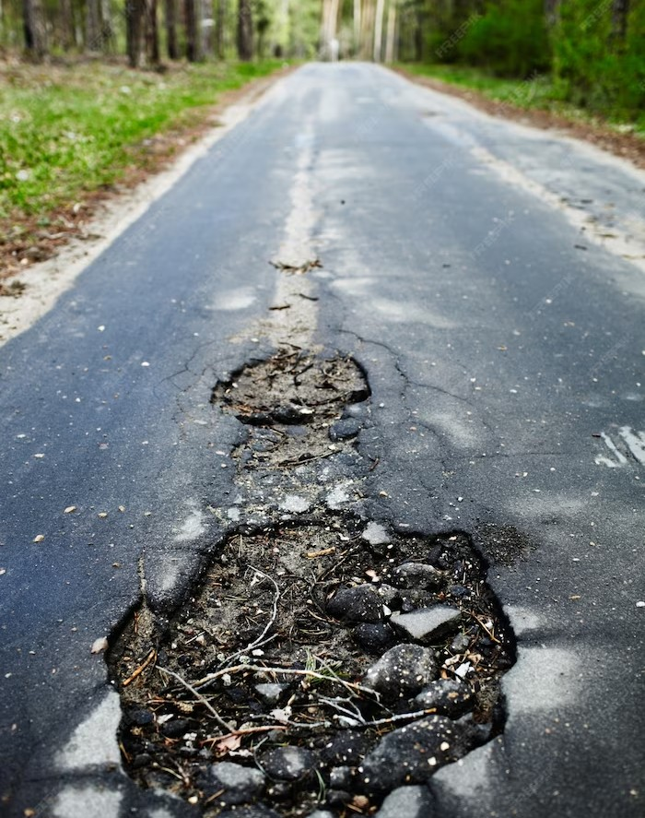
Challenges of Asset Tokenization
Asset tokenization faces several challenges such as regulatory uncertainty, lack of standardization, and security concerns. There is also a need for proper due diligence and valuation of assets before they can be tokenized. However, these challenges can be overcome with proper planning and collaboration between different stakeholders.

Slide 7
Conclusion
Asset tokenization provides several beneﬁts such as increased liquidity, fractional ownership, and transparency. It also enables access to a wider range of investors and reduces the need for intermediaries. Although there are challenges, the potential beneﬁts of asset tokenization make it a promising area for exploration.

Slide 8
Thanks!
Do you have any questions? addyouremail@freepik.com
+91 620 421 838
yourcompany.com

